Slide 1
L.A (not so) Confidential – Examining the diversity of downtown L.A neighbourhoods
‘IBM Data Science Certificate’ Final Capstone Project – Kyriacos Theocharides

Slide 2
Introduction
Aim: Investigate the diversity of L.A neighbourhoods by analysing types of venues and their geographic location.
Who can benefit from this?
Tourists wanting to explore L.A
Businessman/Businesswoman wanting to understand L.A’s demographics before opening a new venue
Researcher wanting to investigate the demographics of L.A by observing the types of venues

Slide 3
Data
The following data was obtained:
Webscraping neighbourhood names using BeautifulSoup library
Latitude and Longitude locations of neighbourhoods
Obtain venues using Foursquare API. Choose only venue name, category and location
Important libraries used:
BeautifulSoup
Geopy
Folium
Matplotlib
Sklearn

Slide 4
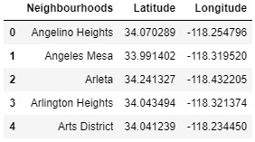
Webscrape Neighbourhood names
Link: https://en.wikipedia.org/wiki/List_of_districts_and_neighborhoods_of_Los_Angeles
Used BeautifulSoup library
Saved to pandas dataframe
Neighbourhood names and location data

Slide 5
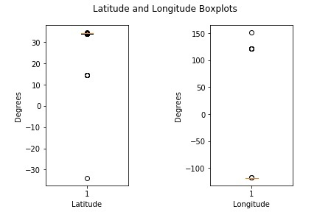
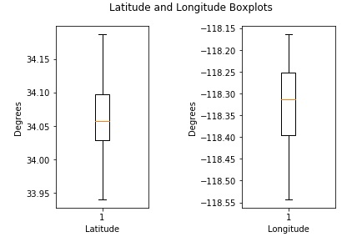
Remove outliers (boxplots)
Before
After

Slide 6
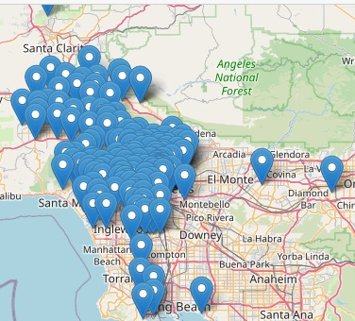
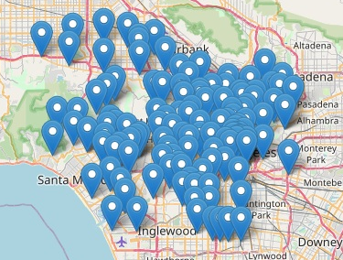
Remove outliers (Folium maps)
Before
After

Slide 7
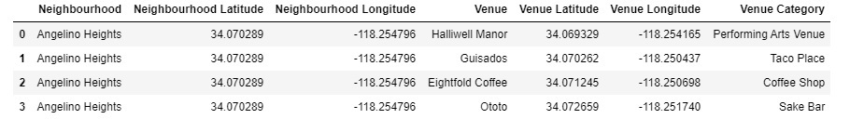
Importing venues
Used Foursquare API
Passed Neighbourhood locations to Foursquare
Returned JSON with venues
Used pandas to make a data frame containing venue and neighbourhood information
Dataframe ‘LA_venues’ containing all venues from all 138 L.A neighbourhoods

Slide 8
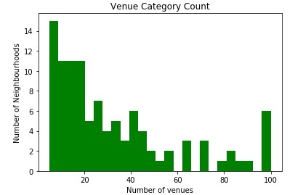
Eliminating neighbourhoods with less than 4 venues
Number of venues per neighbourhood
All neighbourhoods containing less than 4 different venue types were eliminated (circled red)
Reason: neighbourhoods were not diverse enough
Histogram of number of venues and number of neighbourhoods

Slide 9
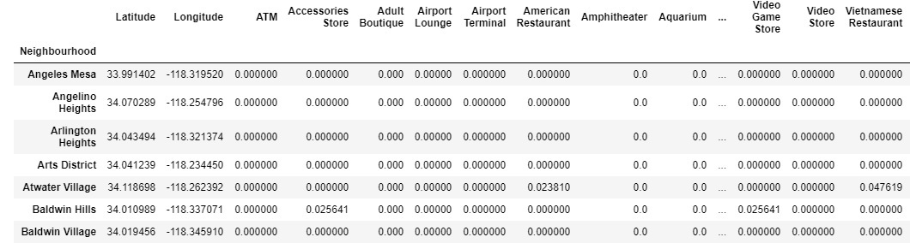
One hot encoding (last step before k-means clustering)
One hot encoding of neighbourhoods and venues

Slide 10
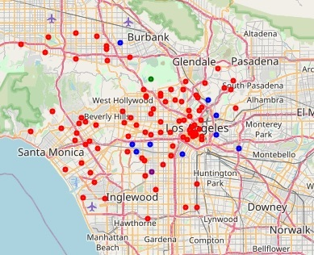
K-means clustering
Cluster | Colour
0 | Red
1 | Blue
2 | Green
3 | Purple
Cluster – colour pairings
Cluster | No. of Neigh.
0 | 93
1 | 9
2 | 1
3 | 1
Clustered neighbourhoods in L.A
Number of neighbourhoods per cluster

Slide 11
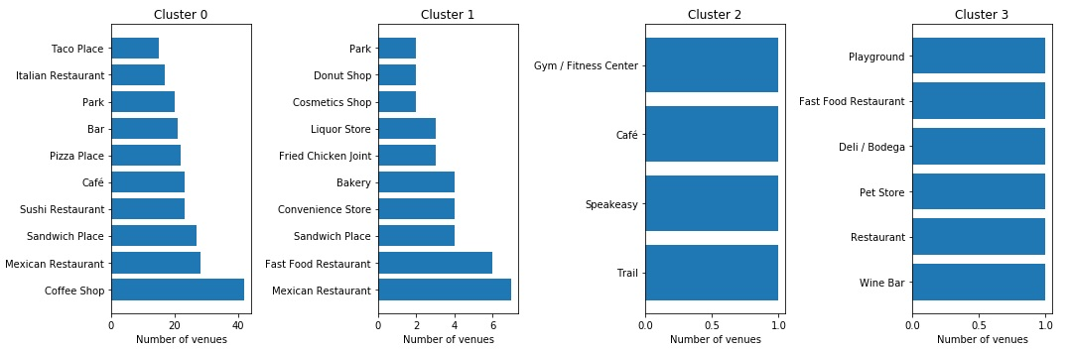
Most common venues per cluster
Most common venues per cluster

Slide 12
Discussion
Around 90% of neighbourhoods fall under cluster 0
Clusters 2 and 3 contain only 1 neighbourhood
Clusters 1 & 2 are dominated by food and drink venues
Cluster 2 shows a heavy Mexican influence with neighbourhoods ‘grouping’ together
Cluster 1 is mostly ‘grab and go’ food and music venues with heavy Mexican, Italian and Asian influence
Lack of diversity due to huge proportion of cluster 0 neighbourhoods and generic food and drink venues in cluster 0

Slide 13
Improvements?
Increase number of clusters to break down ‘monopoly’ of cluster 0 in to more diverse neighbourhoods
Filter all venues other than ethnic restaurants as these are best indicators for demographics in L.A
Filter all food and drink venues so that less popular venues such as cinemas or bowling alleys are not overshadowed by popular and generic food and drink venues

Slide 14
Conclusion
Original goal: examine the diversity of L.A neighbourhoods by clustering the neighbourhoods according to the venues they contain and seeing the position of these clusters on a map of L.A.
Outcome: L.A is not as diverse as I expected since 90% of neighbourhoods fall under one category and most venues are not very insightful (e.g ‘coffee shop’). L.A does contain a strong Mexican, Italian and Asian influence, but there is little insight into venues other than food & drink.
Improvements: Re-run ML model with more clusters; eliminate all venues other than ethnic restaurants; eliminate all food & drink venues to allow less popular venues to be seen which are a better indication of diversity.

